Slide 1
Menopause/
Post-Reproductive Health

Slide 2
What to expect with menopause
Before menopause there is a period of time that the body begins to undergo gradual changes that ultimately lead to menopause.
Some common experiences that you can expect include:
Irregular periods
Hot flashes
Vaginal dryness
Sleep disturbances
Mood swings
Menopause is 12 months without a period, in the absence of other medical conditions. This is a normal and natural process for women as they age!
Notes:
Completed- Nikita

Slide 3
Experiences from real women who are post-menopausal
“The changes, the highs and lows, and the hormonal shifts, there is power in that.”
-Michelle Obama
“I lost myself, broken sleep and brain fog, emotional, a bit all over the place, and I was frightened.”
-Davina McCall
“If you deal with it in a healthy fashion then I think you come out the other side a better person. I’ve got so much more energy now than I ever had in my early 50s before the menopause.”
-Julie Walters
“I see menopause as the start of the next fabulous phase of life as a woman. Now is a time to "tune in" to our bodies and embrace this new chapter. If anything, I feel more myself and love my body more now, at 58 years old, than ever before.”
-Kim Cattrall
Notes:
Completed- Nikita

Slide 4
Therapy to help with menopause symptoms
Types of hormonal therapy
Systemic estrogen: pill, skin patch, ring, gel, cream or spray form
Vaginal products: cream, tablet or ring form
It is important to use products with progesterone along with estrogen
Risks with systemic therapy
Heart disease, stroke, blood clots, breast cancer
Risk increases with age, type of therapy, and health history
Benefits of using hormonal therapy
Prevents bone loss
Alleviates hot flashes, vaginal dryness/itching, sleep
Helps with early menopause/loss of estrogen that is important for female health
Talk to your doctor :)
Notes:
Completed- Nikita

Slide 5
Other remedies for menopausal symptoms
If you would like to avoid using hormone therapy, other treatments include:
Non-hormonal medication therapies
Medications for depression, overactive bladder (oxybutynin)
Lifestyle modifications
Layer clothing and wear breathable material
Maintain a healthy weight and exercise
Avoid trigger foods (spicy foods, alcohol, fatty foods)
Eat regularly and try to increase your protein intake
Natural supplements
Not all supplements are evidence-based, so it’s always a good idea to consult with your doctor before starting any new supplements.
Black cohosh
Red clover
Other supplements (probiotics, prebiotics, cranberry extract, kava, DHEA-S, dong quai, and evening primrose oil)
Notes:
Completed- Nikita

Slide 6
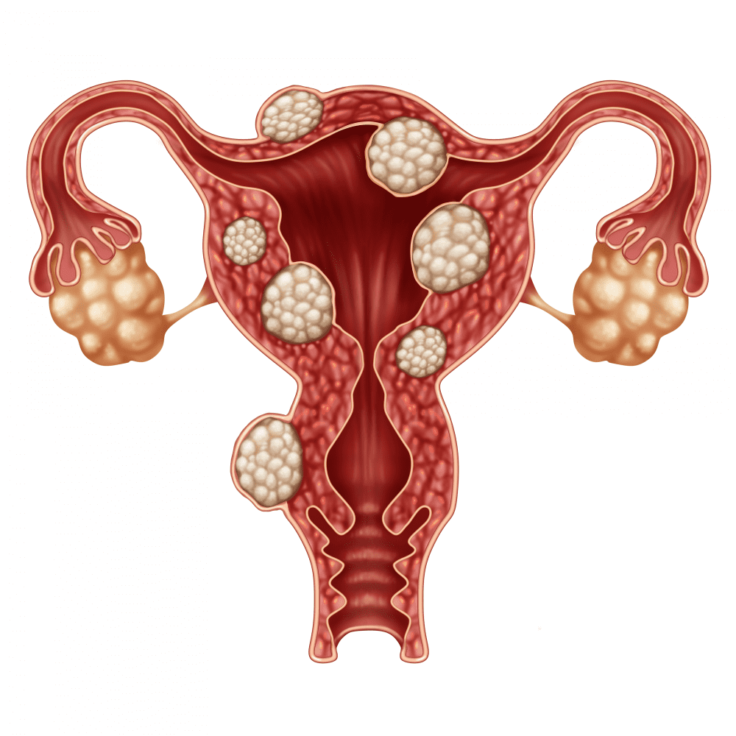
Uterine Fibroids
Fibroids become more common as women age, especially during the 30s and 40s through menopause. After menopause, fibroids usually shrink.
Symptoms seen with fibroids:
Heavy bleeding (which can be heavy enough to cause low blood levels) or painful periods
Feeling of fullness in the lower stomach area
Enlargement of the lower stomach area
Frequent urination
Pain during sex
Lower back pain
Complications during pregnancy and labor, including a six-time greater risk of c-section
Reproductive problems, such as infertility, which is very rare
Most women with fibroids do not have any symptoms. For women who do have symptoms, there are treatments that can help. Talk with your doctor about the best way to treat your fibroids.
Notes:
Completed- Nikita

Slide 7
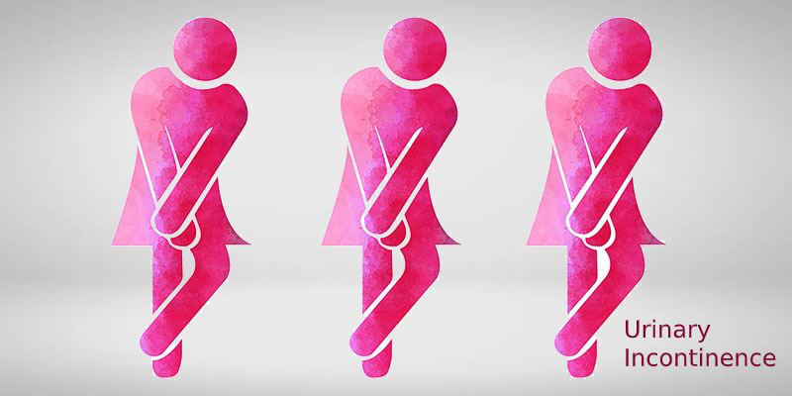
Urinary Incontinence
Urinary incontinence, sometimes called overactive bladder, is the loss of bladder control.
It affects twice as many women as men because reproductive health events unique to women, like pregnancy, childbirth, and menopause, affect the bladder, urethra, and other muscles that support these organs.
It can happen to women at any age, but it is more common in older women. More than 4 in 10 women 65 and older have loss of bladder control..
It is not a disease by itself and may be a symptom of another health problem, usually weak pelvic floor muscles, overweight, constipation, surgery, nerve damage, certain medications, caffeine, infection
Symptoms can be reduced through bladder training,schedule toilet trips, fluid and diet management, pelvic floor muscle exercises(Kegels exercise)
You may feel uncomfortable discussing incontinence with your doctor. But if incontinence is frequent or is affecting your quality of life, it's important to seek medical advice
Notes:
Completed- Nikita

Slide 8
Breast Changes
With age, a woman's breasts lose fat, tissue, and mammary glands. Many of these changes are due to the decrease in the body's production of estrogen that occurs at menopause.
Common changes that occur in the breasts due to age include:
Stretch marks
Downward pointing nipples
An elongated, stretched, or flattened appearance
Wider spaces between the breast
Some concerning breast signs to look for:
Puckering
Redness
Thickening of breast skin
A pulled in nipple
Nipple discharge
Breast pain
Hard lumps
One breast looks significantly different than the other
If you notice a lump, make an appointment with your healthcare provider, because breast cancer risk increases with age.
Notes:
Completed- Nikita

Slide 9
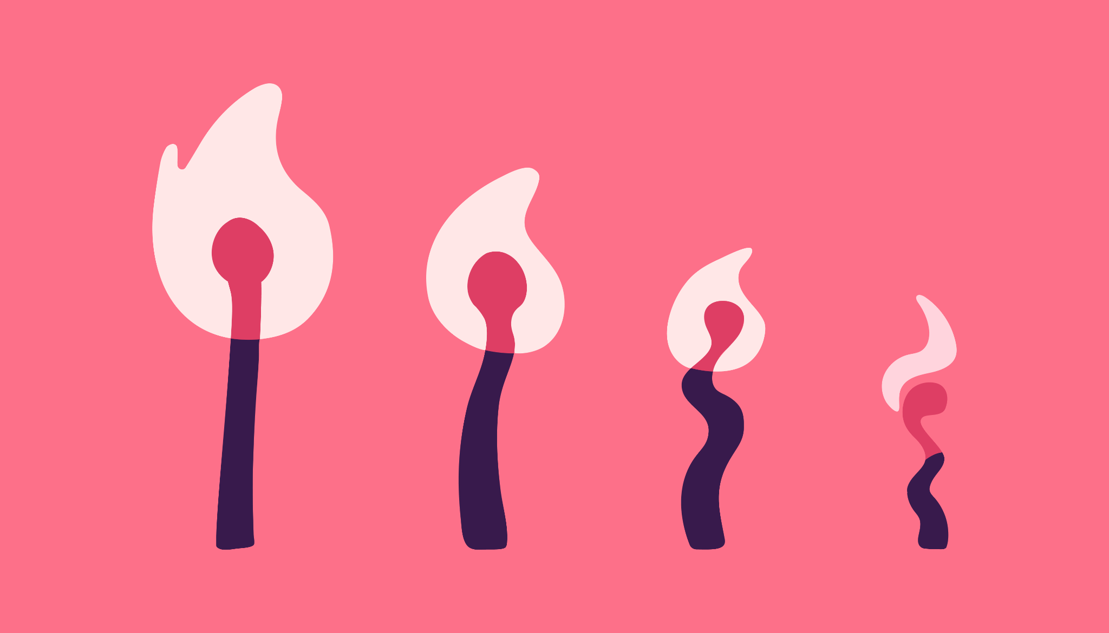
Sex and Menopause
Three of the most common concerns related to sex during menopause are vagina dryness, pain and a lack of desire.
Painful intercouse can have other causes, too, so if you’re experiencing pain during intercourse, it’s wise to have a checkup.
Many treatments are available to help with the troublesome symptoms and its advisable to communicate with your doctor to find the best choice for you.
Notes:
Completed- Nikita

Slide 10
Bone health
Menopause can increase bone loss and the risk of osteoporosis.
Osteoporosis: decreased density + strength of bones, can cause broken bones.
Symptoms: Back pain, bone fractures, decreased height
Bone strength is affected by estrogen level, vitamin D level, calcium levels.
Screening for Osteoporosis: All women over the age of 65 should receive a bone density screening test.
Lifestyle changes to improve bone health:
Resistance, balance, weight-bearing exercises
Balanced diet + sunshine (for vitamin D!)
Avoid smoking + limit alcohol consumption
There are many medication options for osteoporosis. Ask your doctor about treatment!
Notes:
https://www.endocrine.org/-/media/endocrine/files/patient-engagement/patient-guides/patient_guide_bone_health_and_postmenopausal_women.pdf

Slide 11
Other Health Screenings: Breast Cancer
At what age is it recommended that women start getting routine mammograms?
35 years
40 years
50 years
55 years

Slide 12
Other Health Screenings: Breast Cancer
At what age is it recommended that women start getting routine mammograms?
35 years
40 years
50 years
55 years
For average-risk women (e.g. no family history of breast cancer), breast cancer screening by mammography is recommended for women ages 40-74 every 1-2 years. At age 75 and older, mammograms can be done every 2 years.

Slide 13
Other Health Screenings: Breast Cancer
A 27 year old woman comes to the doctor asking about routine screening. Her mother was diagnosed with breast cancer at age 36. When should she schedule her first mammogram?
Now, at 27
30 years
36 years
40 years

Slide 14
Other Health Screenings: Breast Cancer
A 27 year old woman comes to the doctor asking about routine screening. Her mother was diagnosed with breast cancer at age 36. When should she schedule her first mammogram?
Now, at 27
30 years
36 years
40 years
Women with significant risk factors (BRCA mutation in self or first-degree relative (a parent, sibling, or child), chest radiation between ages 10-30 years) should get yearly mammograms and breast MRIs beginning at age 30, or at an age younger than the age at which a first-degree family member was diagnosed with breast cancer.

Slide 15
Other Health Screenings: Cervical Cancer
When should women start getting routine Pap smears?
Age 18
Age 21
Age 30
As soon as they becomes sexually active

Slide 16
Other Health Screenings: Cervical Cancer
When should women start getting routine Pap smears?
Age 18
Age 21
Age 30
As soon as they becomes sexually active
To prevent cervical cancer, Pap tests are recommended starting at age 21 and should be repeated every 3 years, or sooner for abnormal results. Women 30-65 years can continue Pap tests every 3 years or opt for cotesting (Pap + HPV testing) every 5 years. Women without a uterus and cervix (i.e. history of total hysterectomy) who have never been diagnosed with cervical cancer do not need routine Pap smears.

Slide 17
Other Health Screenings: Colorectal Cancer
When are regular screening colonoscopies recommended?
Age 35
Age 40
Age 45
Age 50

Slide 18
Other Health Screenings: Colorectal Cancer
When are regular screening colonoscopies recommended?
Age 35
Age 40
Age 45
Age 50
Current guidelines state that individuals with an average-risk of colorectal cancer begin screening with routine colonoscopies starting at age 45. Colonoscopies should be repeated every 10 years until age 75, unless instructed to return earlier by a physician. Between ages 76-85, colonoscopy frequency is determined by a patient’s risk factors, previous screening results, life expectancy, overall health, and preferences. Colorectal cancer screening is generally not recommended beyond the age of 85 years.

Slide 19
Risk Factors: Colorectal Cancer
Modifiable | Non-modifiable
Being overweight/obese (BMI >24.9) | Age >50
Sedentary lifestyle | Personal history of polyps or colorectal cancer (CRC)
Diet high in red/processed meats | Personal history IBD (Crohn’s, ulcerative colitis)
Smoking | Family history of high-risk (i.e. adenomatous) polyps or CRC
Alcohol use | Inherited disease (e.g. Lynch, FAP, Peutz-Jeghers)
Poorly-controlled type 2 diabetes | Type 2 diabetes

Slide 20
Other Health Screenings: Breast Cancer
A 24 year old woman comes to the doctor asking about routine screening. Her father was diagnosed with colon cancer at age 43. When should she schedule her first colonoscopy?
Now, at 24
33 years
43 years
45 years

Slide 21
Other Health Screenings: Breast Cancer
A 24 year old woman comes to the doctor asking about routine screening. Her father was diagnosed with colon cancer at age 43. When should she schedule her first colonoscopy?
Now, at 24
33 years
43 years
45 years
Individuals with a first-degree relative who have or had colorectal cancer should start regular screening earlier, at age 40 or 10 years before the age at which the relative received their diagnosis. Colonoscopies in these high-risk patients should be repeated every 5 years.

Slide 22
Other Health Screenings: Cholesterol
A 41 year old woman comes to the doctor’s office to discuss the results of her cholesterol screening test. She asks the doctor about the normal range of total cholesterol levels. What should the doctor tell her?
<200 mg/dL
200-239 mg/dL
>240 mg/dL

Slide 23
Other Health Screenings: Cholesterol
A 41 year old woman comes to the doctor’s office to discuss the results of her cholesterol screening test. She asks the doctor about the normal range of total cholesterol levels. What should the doctor tell her?
<200 mg/dL
200-239 mg/dL Borderline High
>240 mg/dL High
Women should have their cholesterol levels checked starting at age 45, or age 40 in women with risk factors for cardiovascular disease (e.g. diabetes, high blood pressure, kidney disease, smoking, family history of heart or cardiovascular disease). Blood lipid panels should be repeated every 5 years, or sooner if indicated by your doctor.

Slide 24
Other Health Screenings: Cholesterol
Which of the following is NOT a type of cholesterol?
Triglycerides
HDL
LDL
Ferritin

Slide 25
Other Health Screenings: Cholesterol
Which of the following is NOT a type of cholesterol?
Triglycerides
HDL
LDL
Ferritin
Ferritin is a blood protein that contains iron. Doctors use ferritin levels to understand how much iron is stored in a patient’s body.

Slide 26
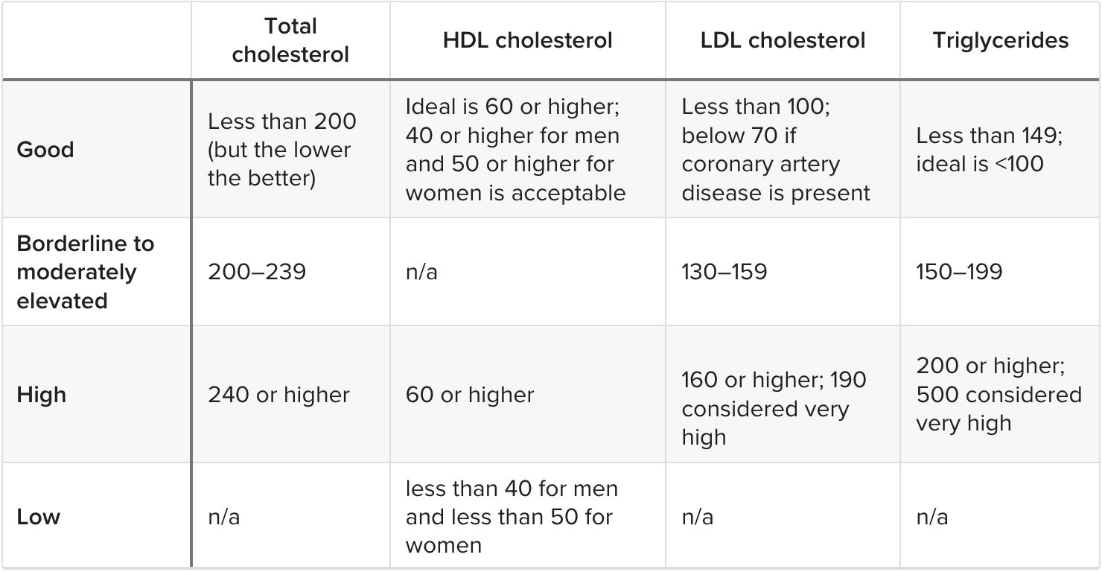
Other Health Screenings: Cholesterol

Slide 27
Other Health Screenings: Immunizations
When should I get the…
Influenza vaccine?
Pneumonia vaccine?
Shingles vaccine?
Tetanus vaccine?

Slide 28
Other Health Screenings: Immunizations
When should I get the…
Influenza vaccine? Every year
Pneumonia vaccine? Age 65
Shingles vaccine? Age 50
Tetanus vaccine? Tdap once in life, Td booster every 10 years
Immunizations are an effective way to prevent disease and protect the community. Talk to your doctor about which vaccines are recommended for you.

Slide 29
Alarm signs
Vaginal bleeding after fully entering menopause
Don’t ignore, see a gynecologist
Significant weight loss, loss of appetite

Slide 30
Questions?

